Slide 1

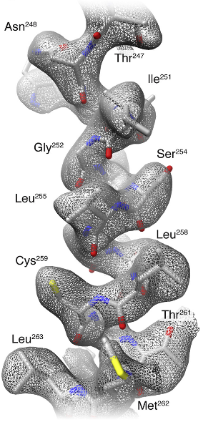
Model Building Workshop
Roberto Marabini
Marta Martínez

Slide 2
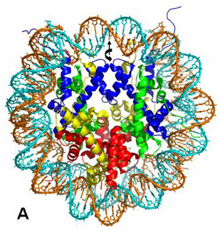
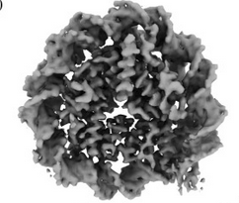
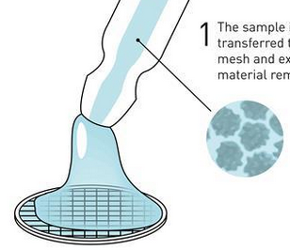
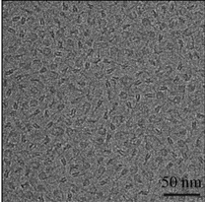
Model building
Sample
Data
Electron density map
Atomic structure
Cryo-EM
> 2010
Fitting
Refinement
Validation
(Takizawa et al., 2018)
4.0 Å resolution
(Takizawa et al., 2018)
1.9 Å resolution
(Davey et al., 2002)
Detailed mechanistic studies
SPA workflow
Drug development
Reliability of atomic models
Notes:
Difraction pattern

Slide 3
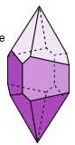
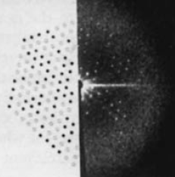
Model building
Sample
Data
Electron density map
Atomic structure
XR
crystallography
> 1950
(Saxton & Baumeister, 1982)
Fitting
Refinement
Validation
Cryo-EM
4.0 Å resolution
(Takizawa et al., 2018)
1.9 Å resolution
(Davey et al., 2002)
> 2010
Detailed mechanistic studies
SPA workflow
Drug development
(Takizawa et al., 2018)
Reliability of atomic models
Notes:
Difraction pattern

Slide 4
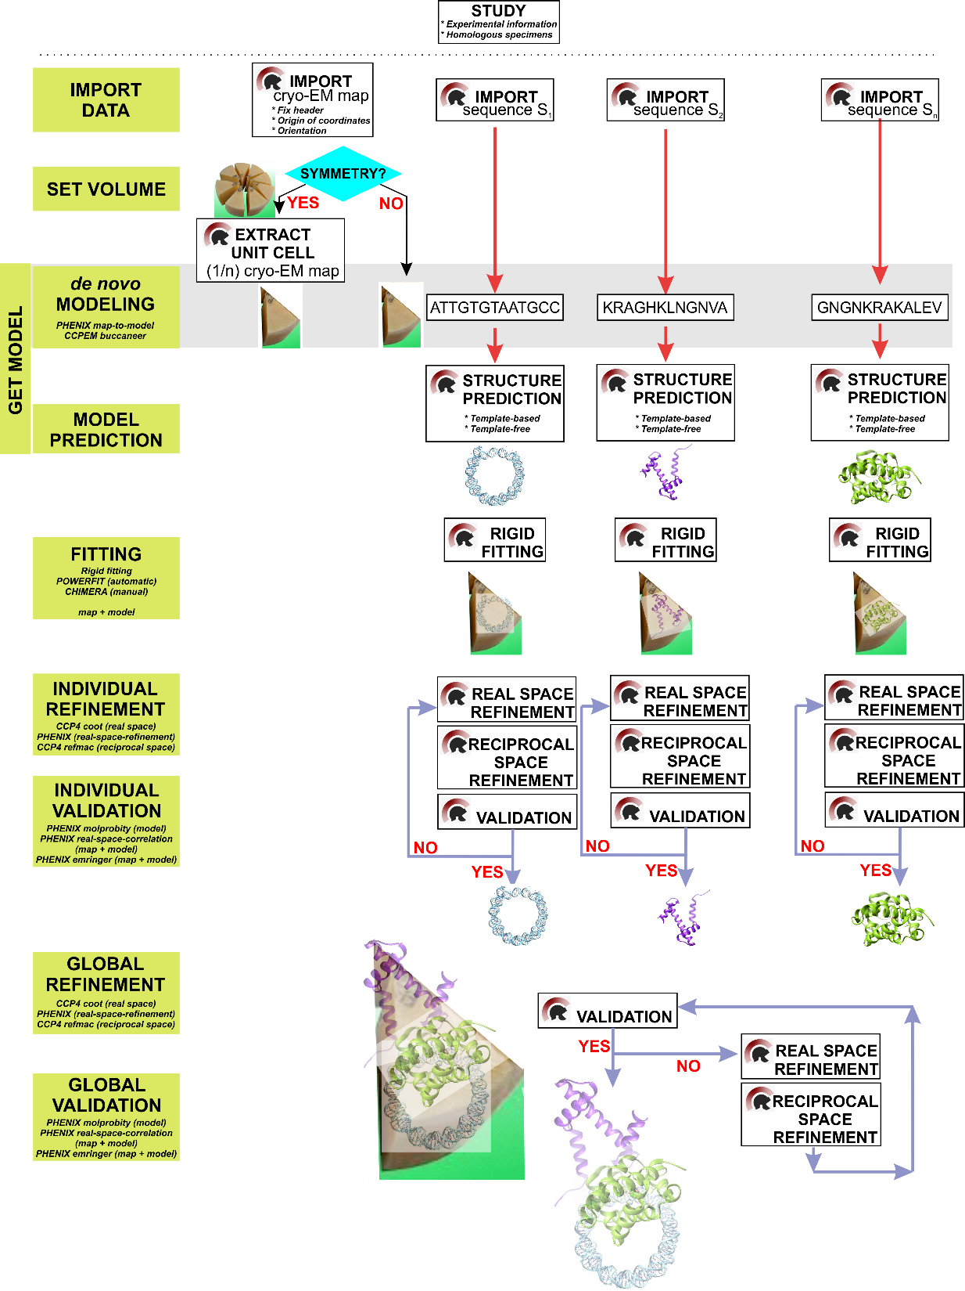

Slide 5
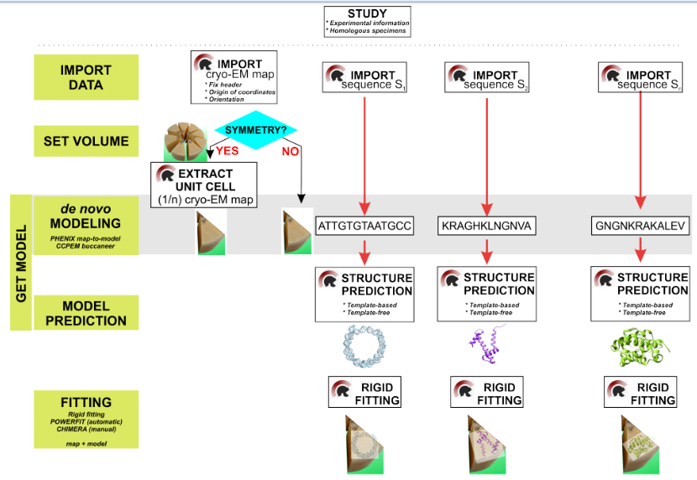

Slide 6

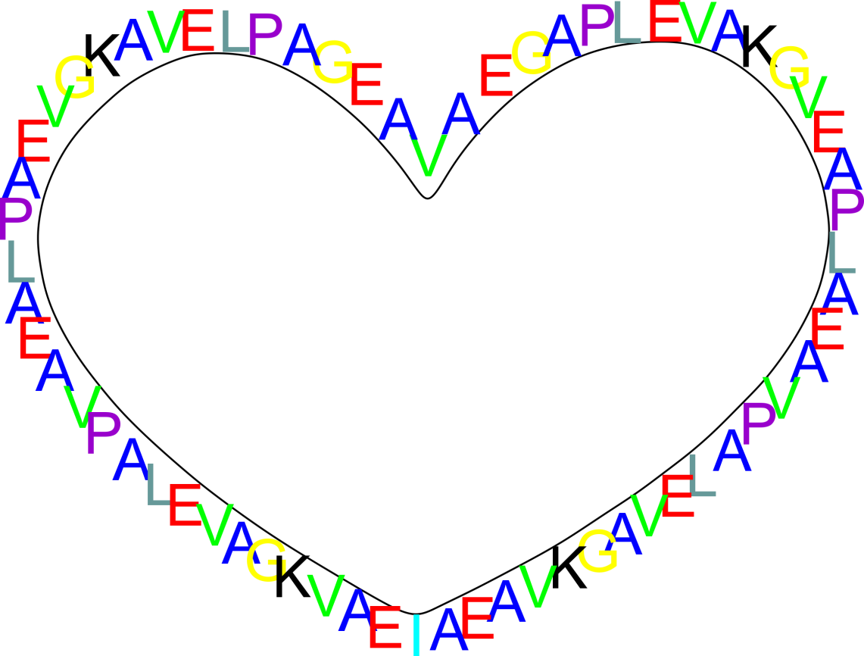
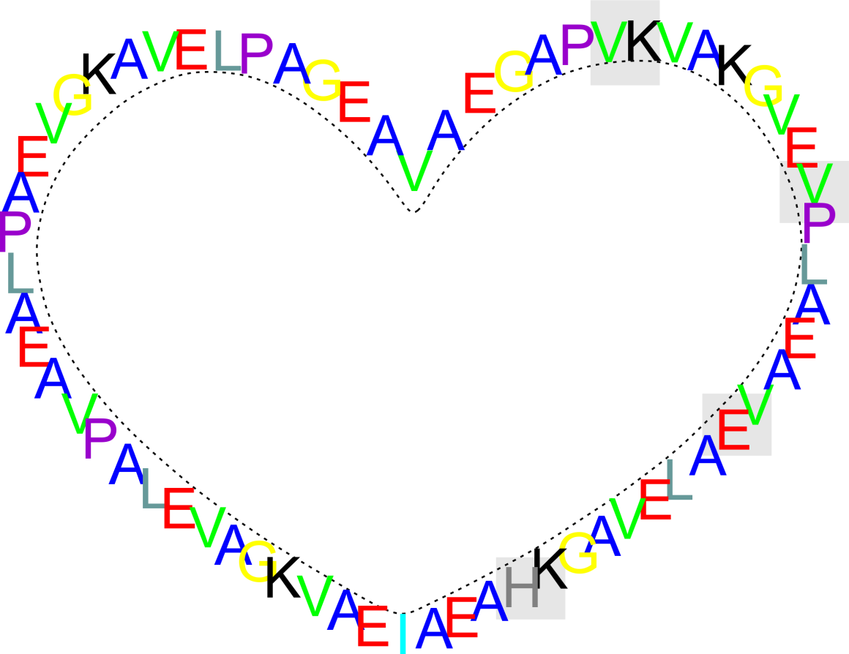

Slide 8
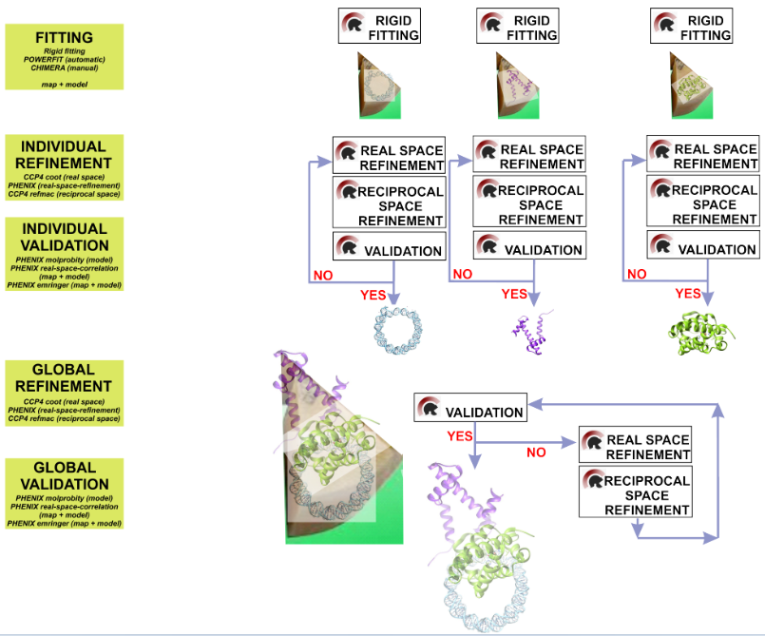

Slide 11
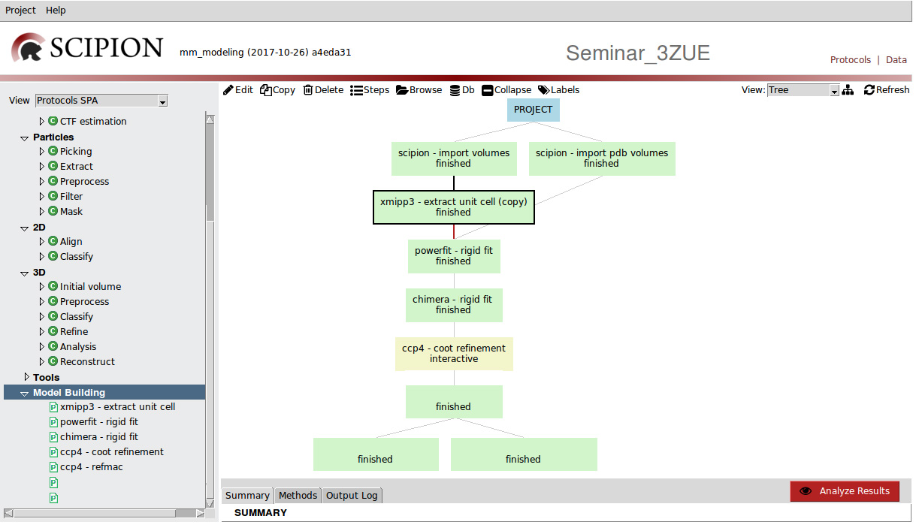
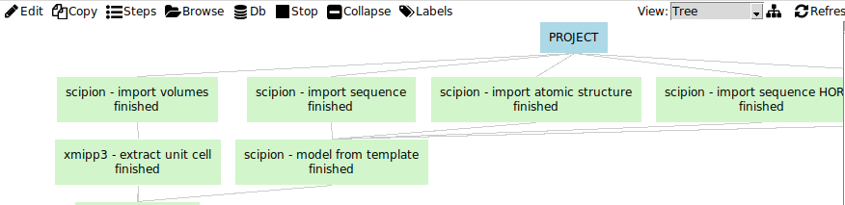
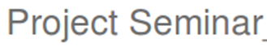
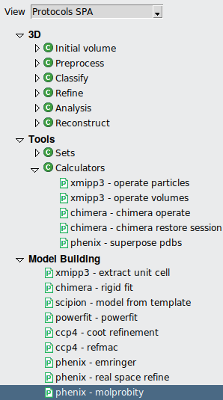
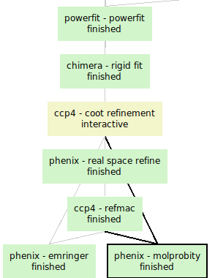
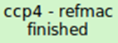
Fitting
LOCAL refinement in the REAL SPACE
Refinement
GLOBAL refinement in the FOURIER SPACE
Validation
fraser - lab - emringer
molprobity
fraser - lab - emringer
molprobity

Slide 12




Slide 13
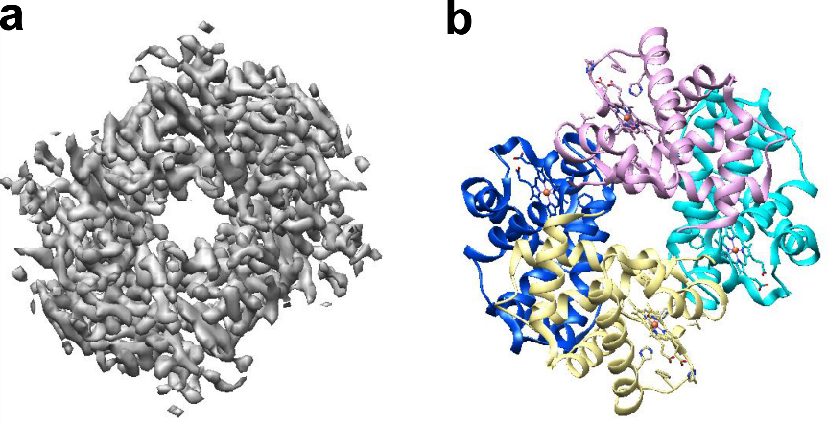

Slide 14


Slide 15
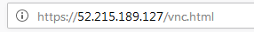
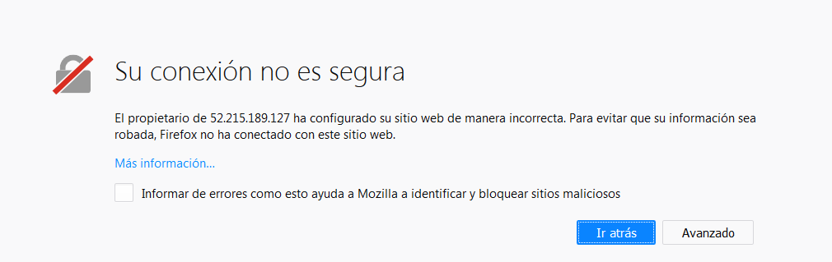
Accept exception

Slide 16
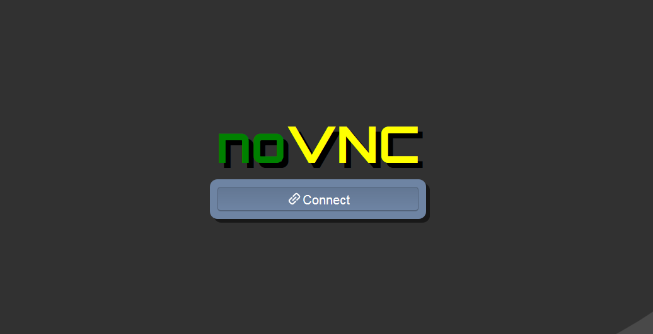
password: Scipion4u

Slide 17
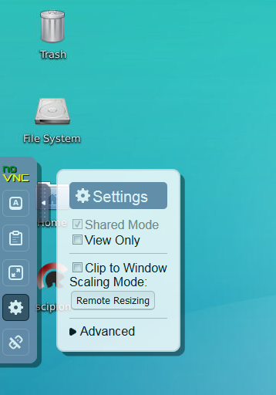
3
2
1

Slide 19
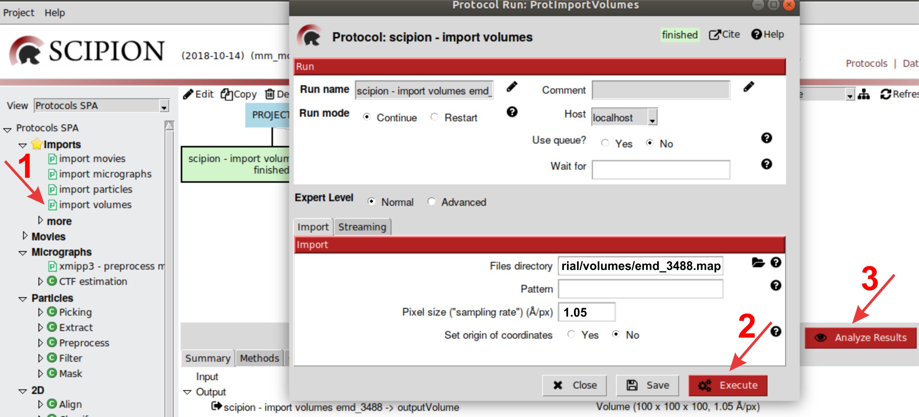
Download volume: http://www.ebi.ac.uk/pdbe/entry/emdb/EMD-3488

Slide 20
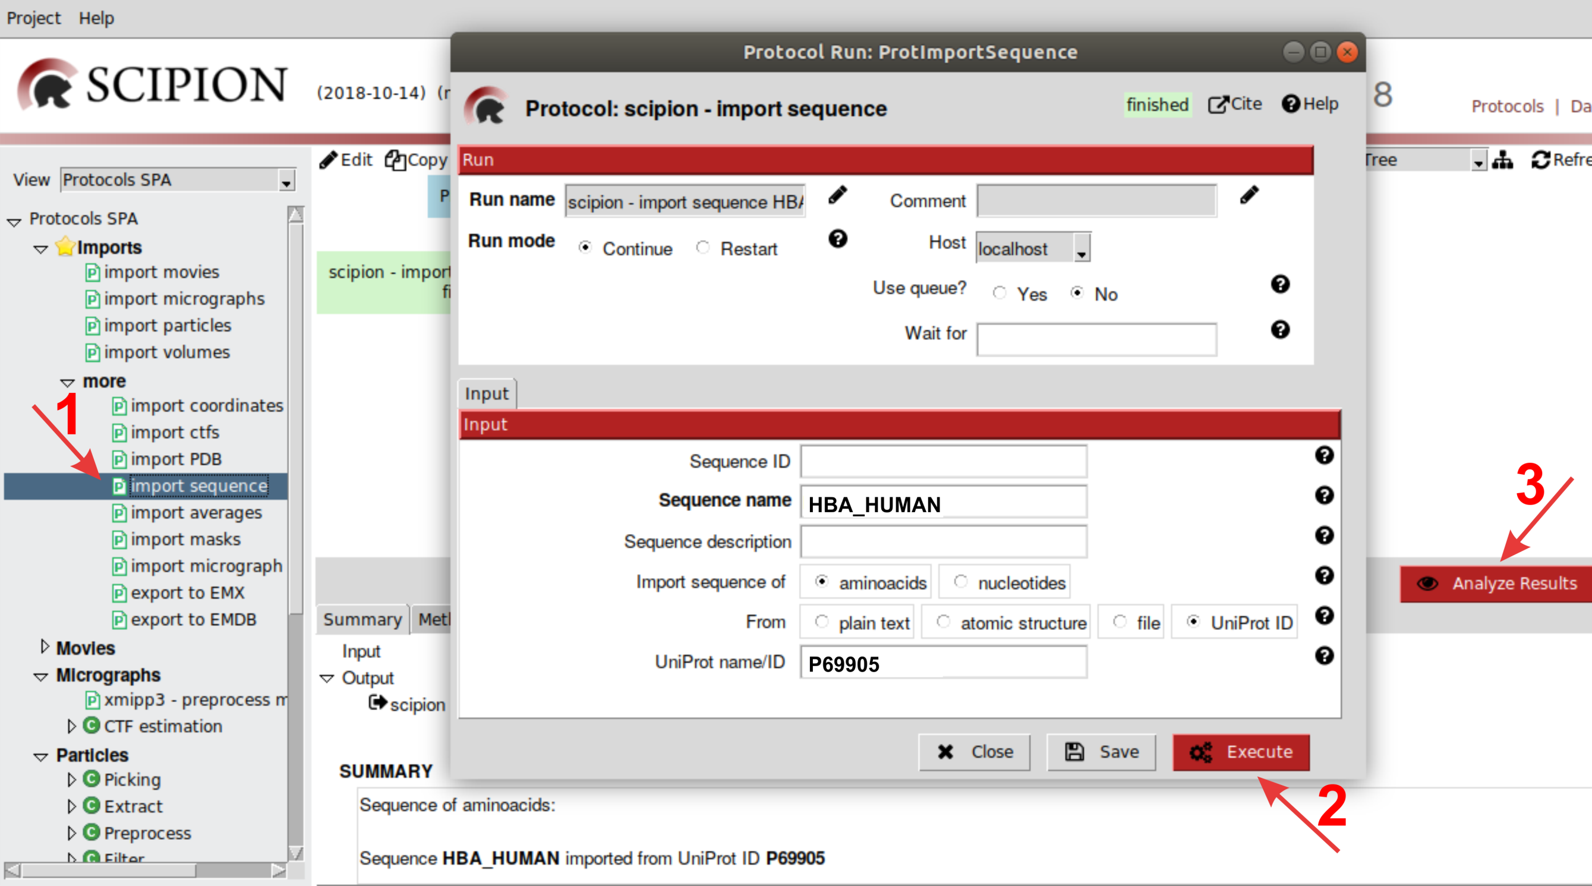

Slide 22
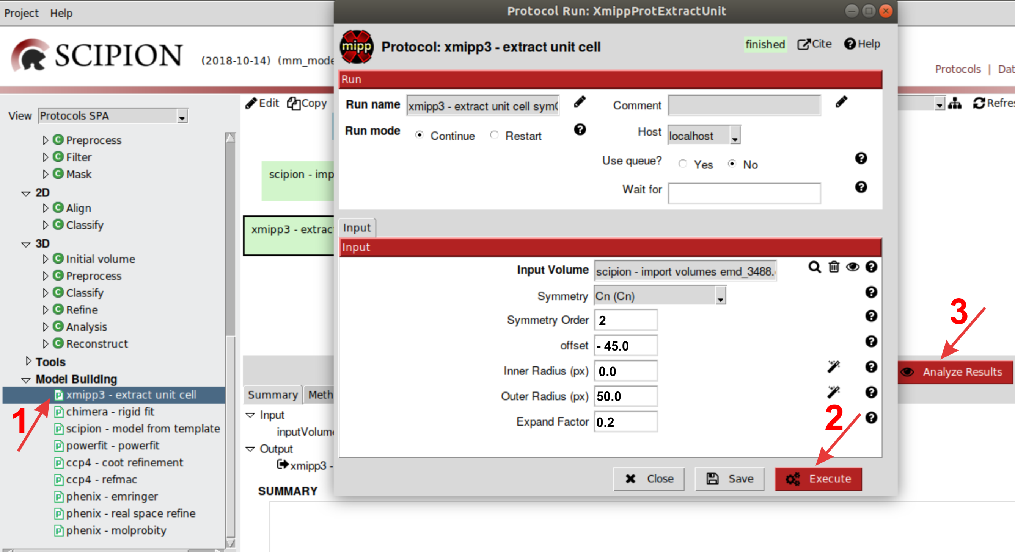

Slide 23
PBX1

Slide 24
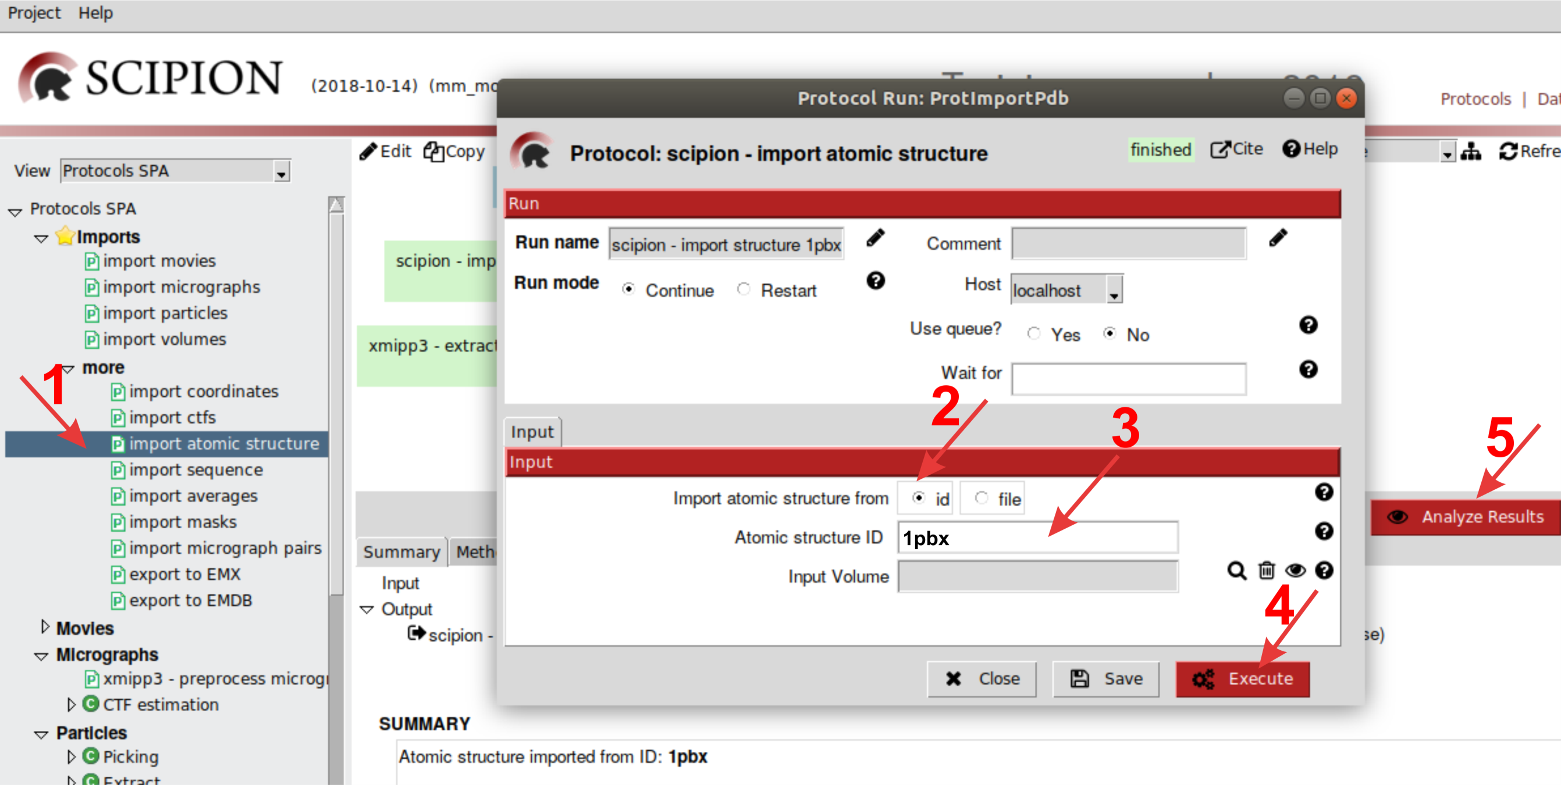

Slide 25
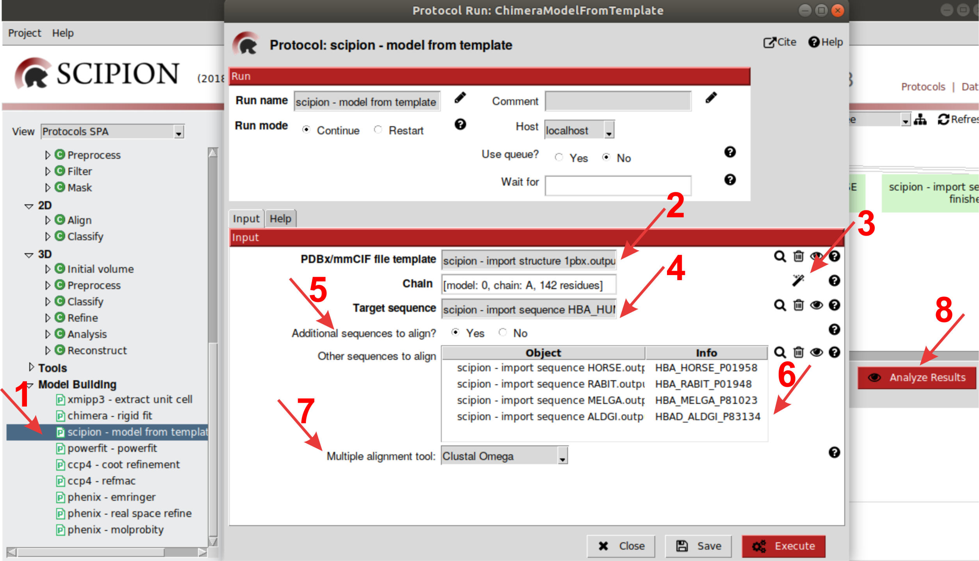

Slide 26
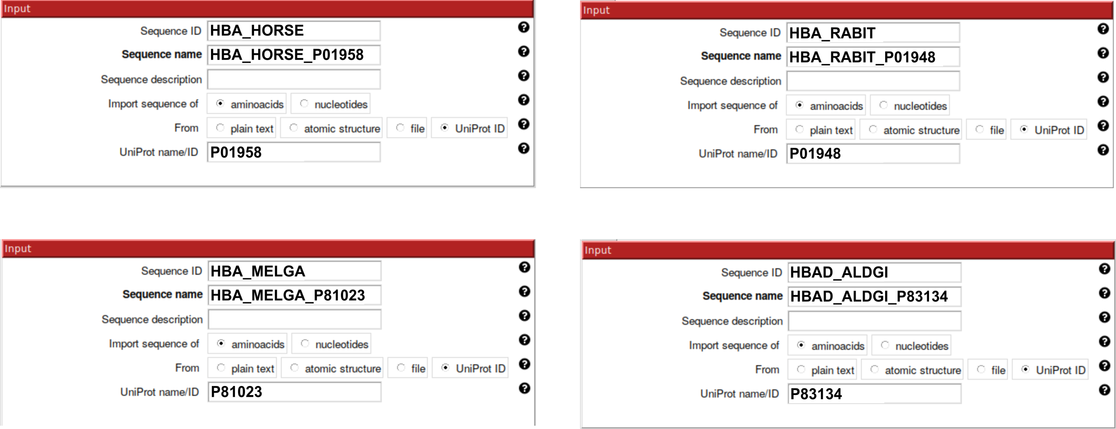

Slide 28
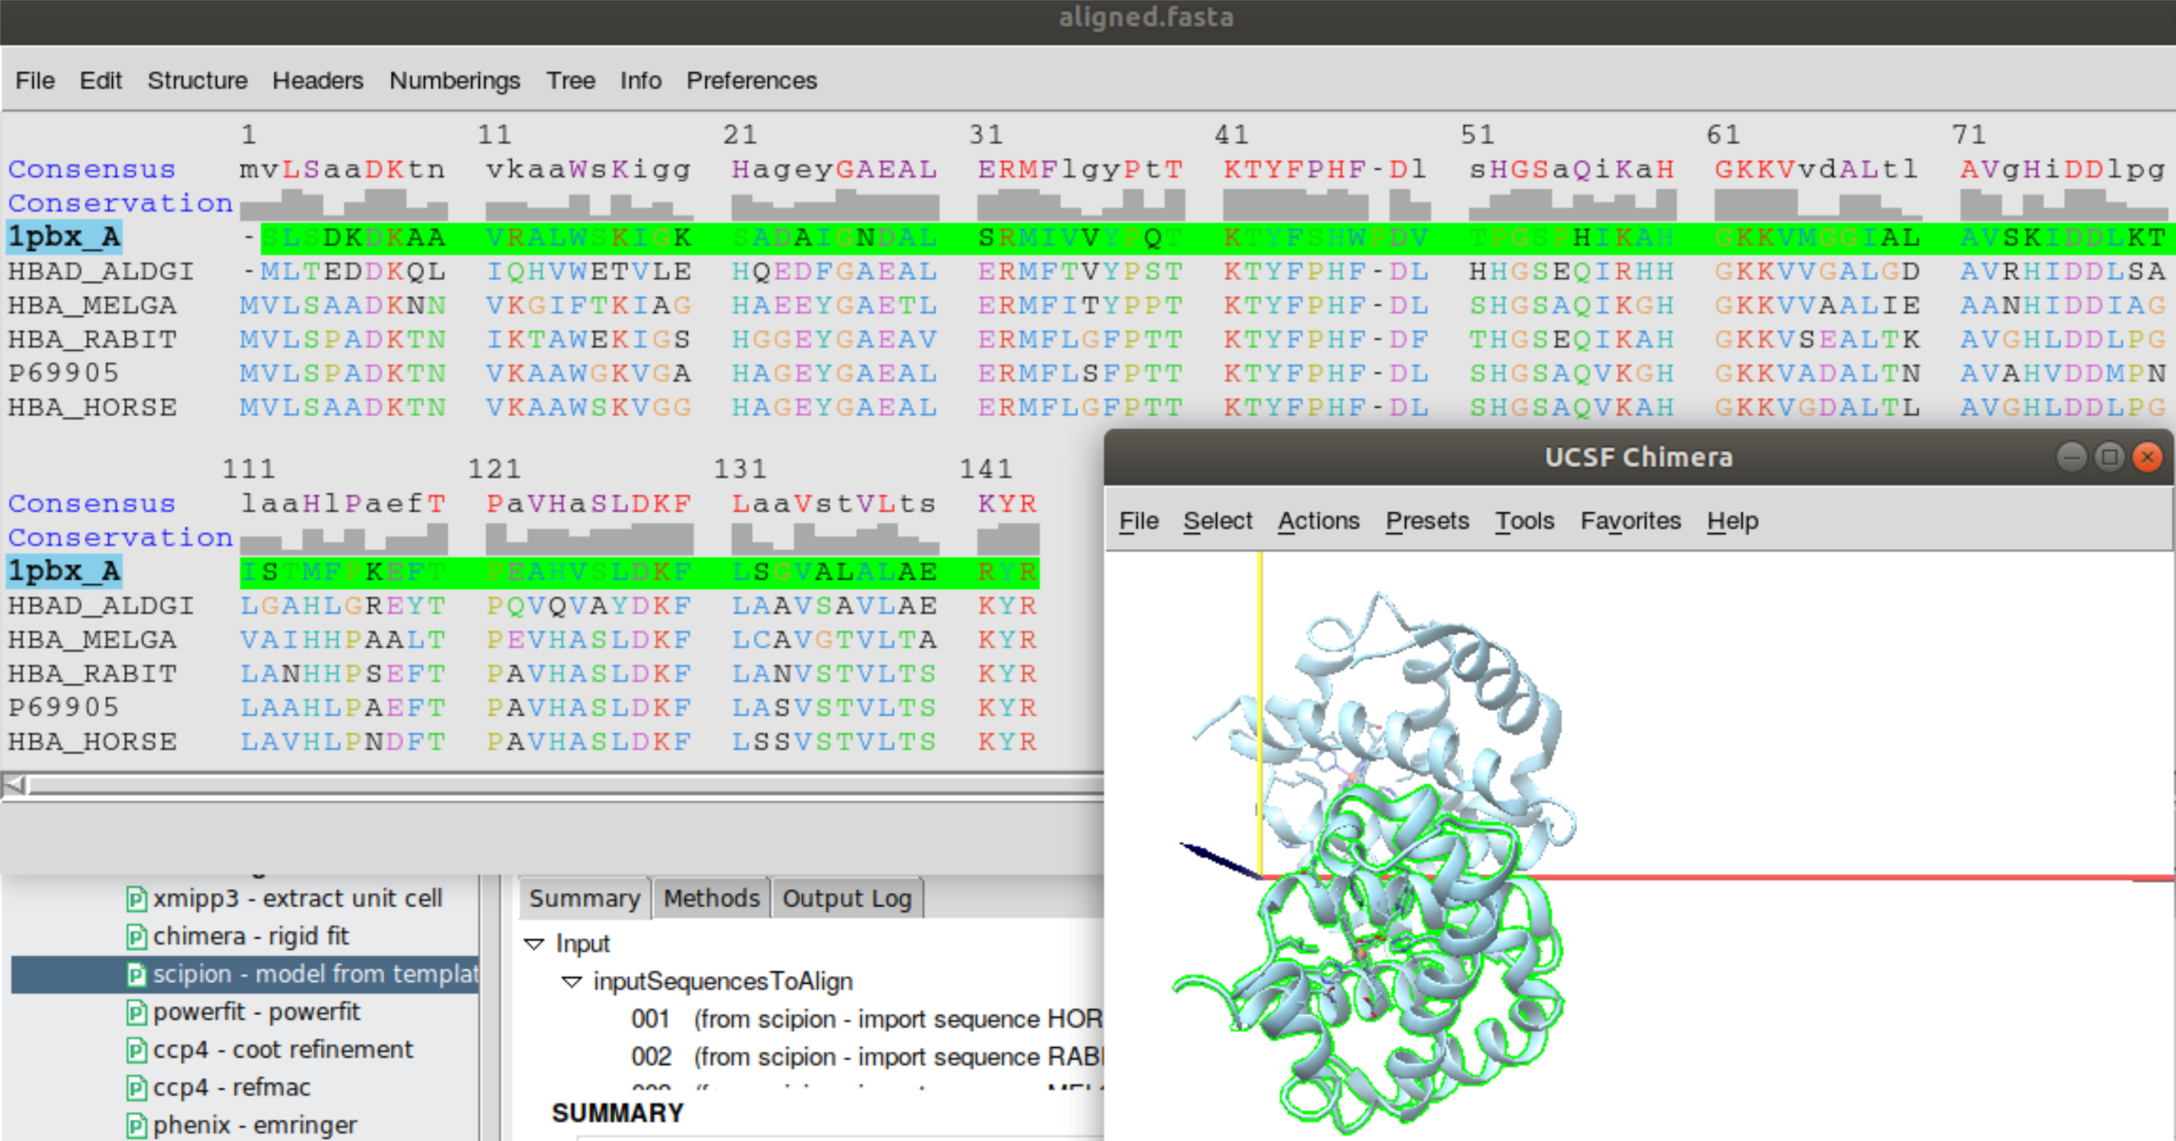

Slide 29
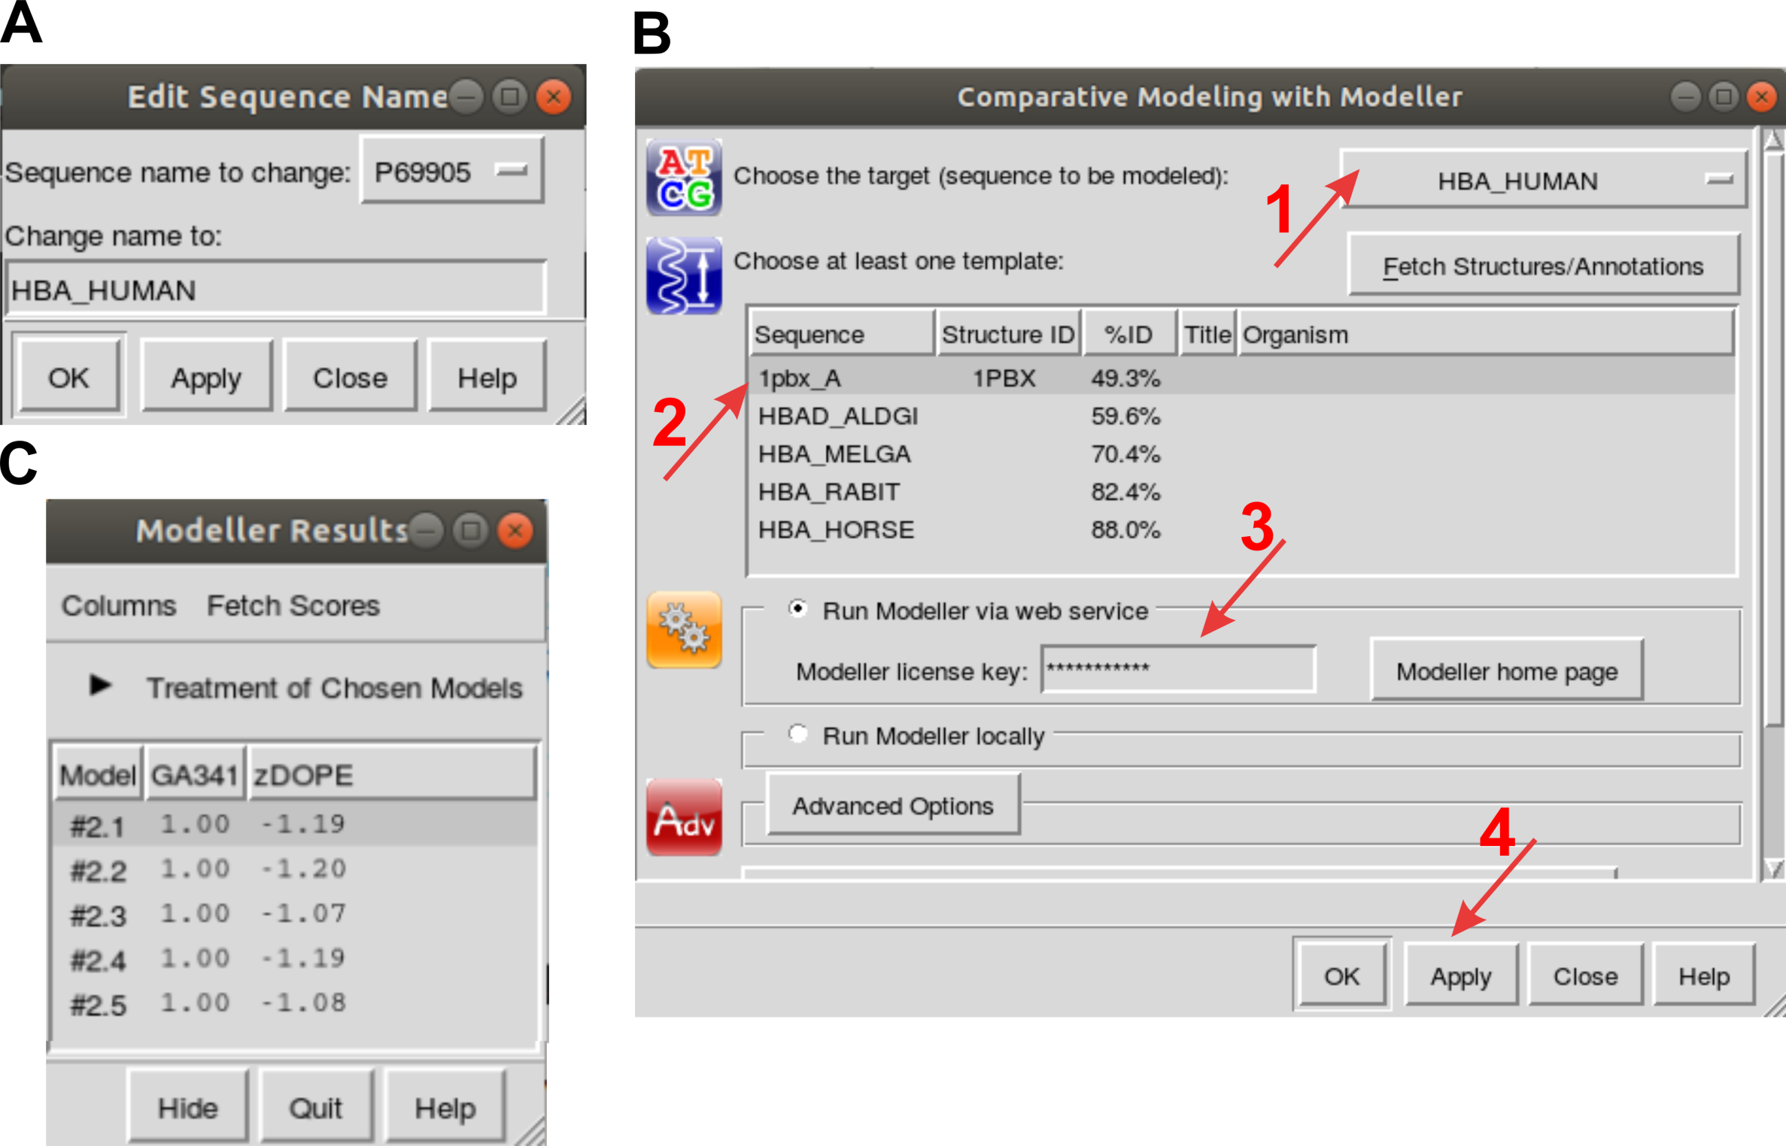

Slide 30
delete #1:0-143.A
delete #1:145-.A
delete #1:.B

Slide 31
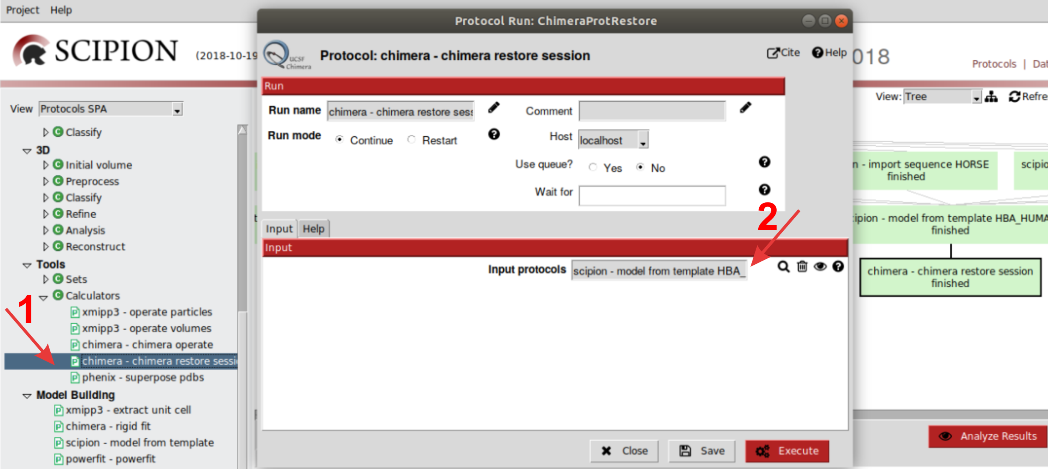

Slide 32
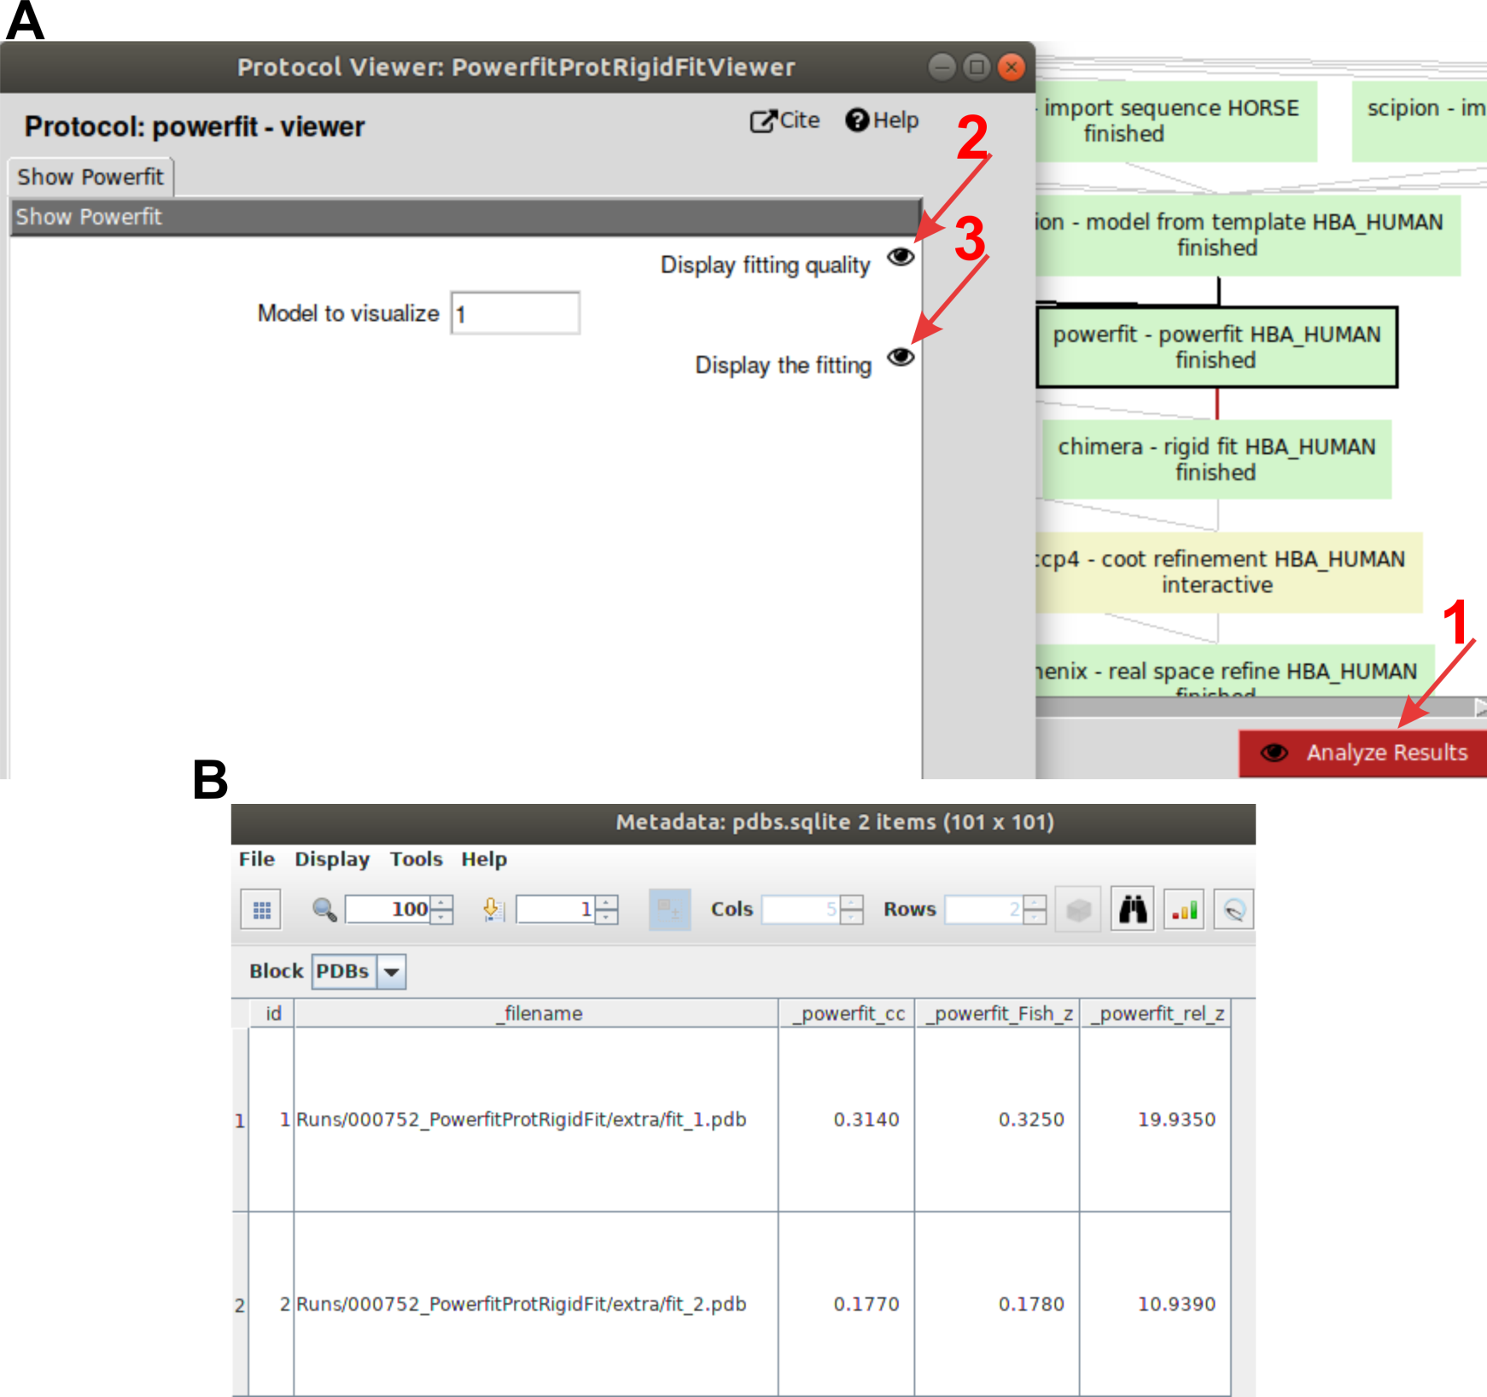

Slide 33
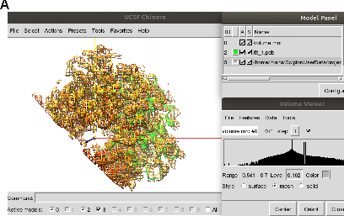
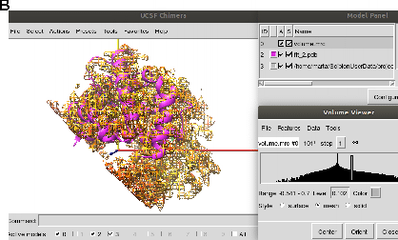

Slide 34
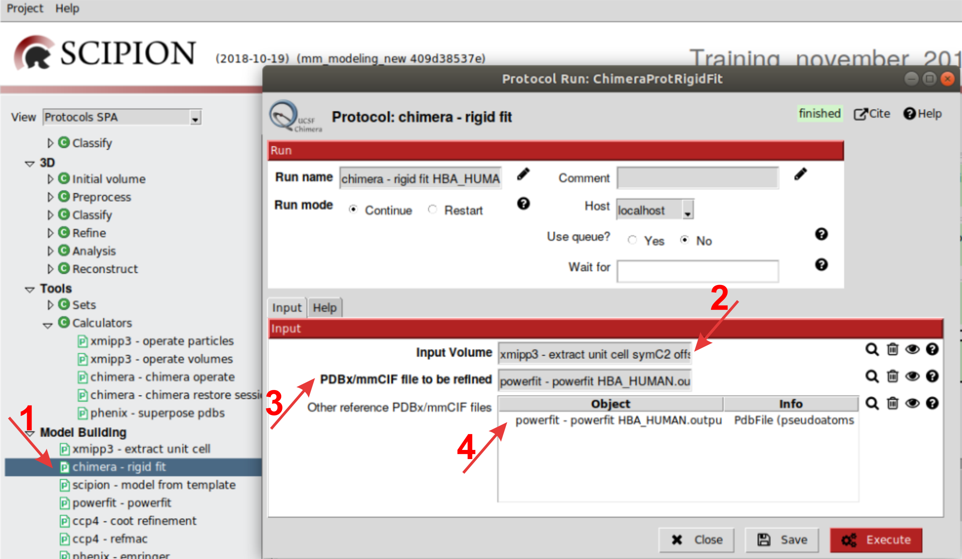

Slide 35
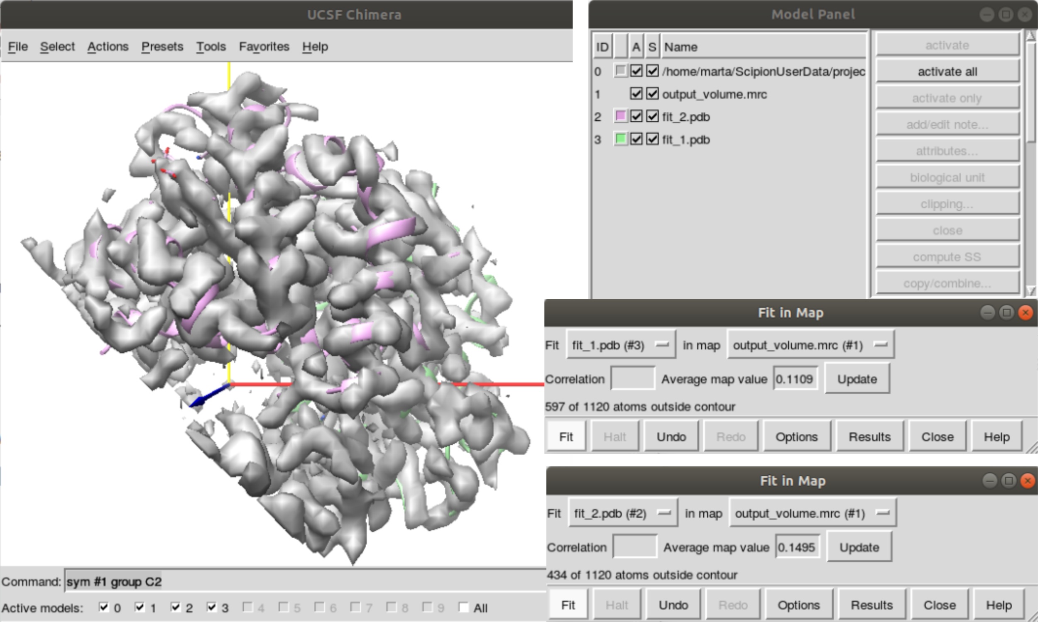

Slide 36
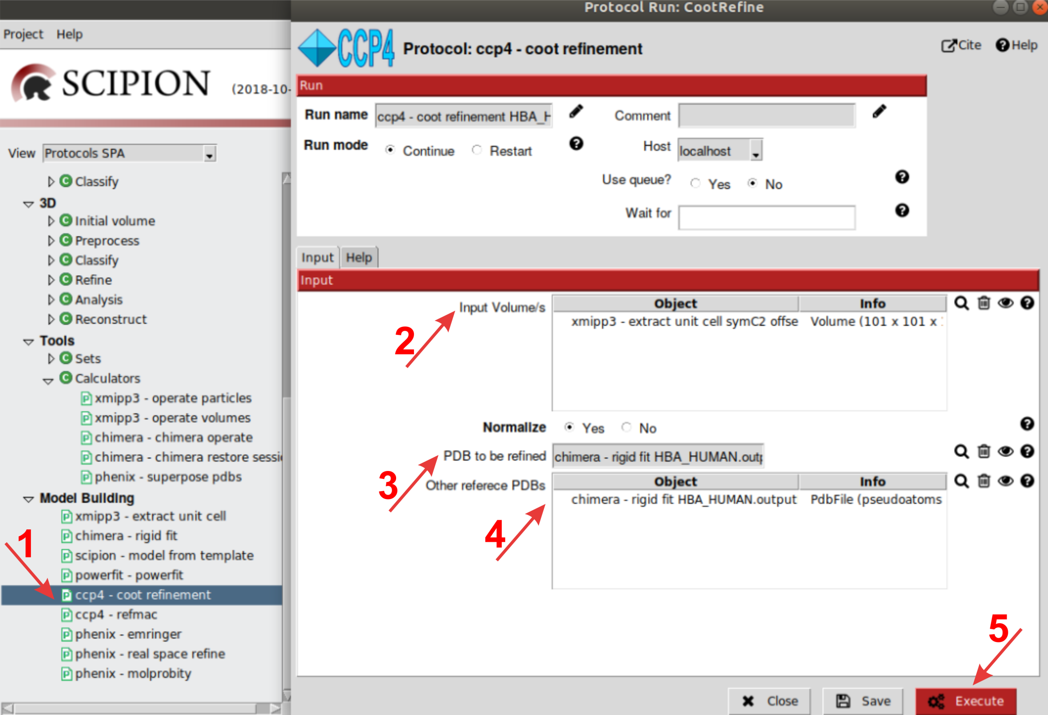

Slide 37
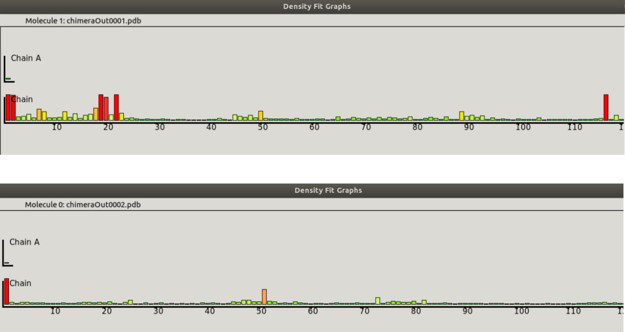

Slide 38
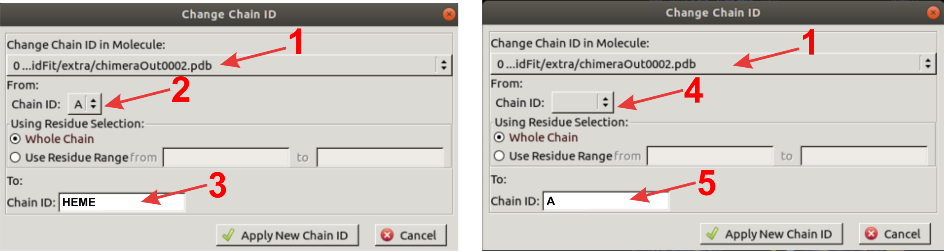

Slide 39
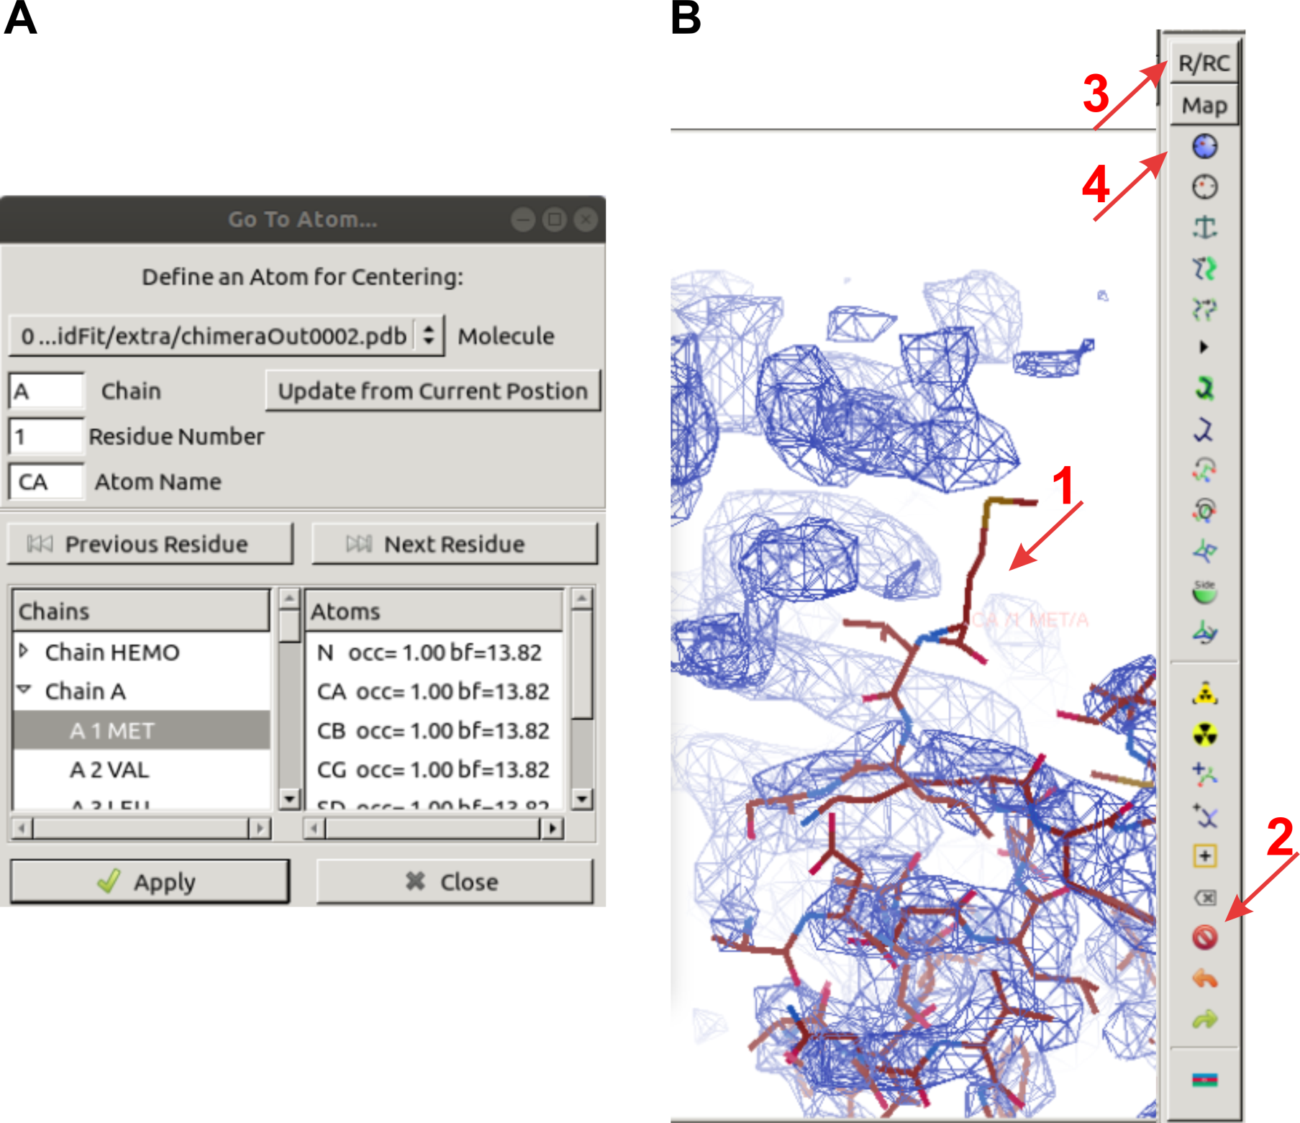

Slide 40
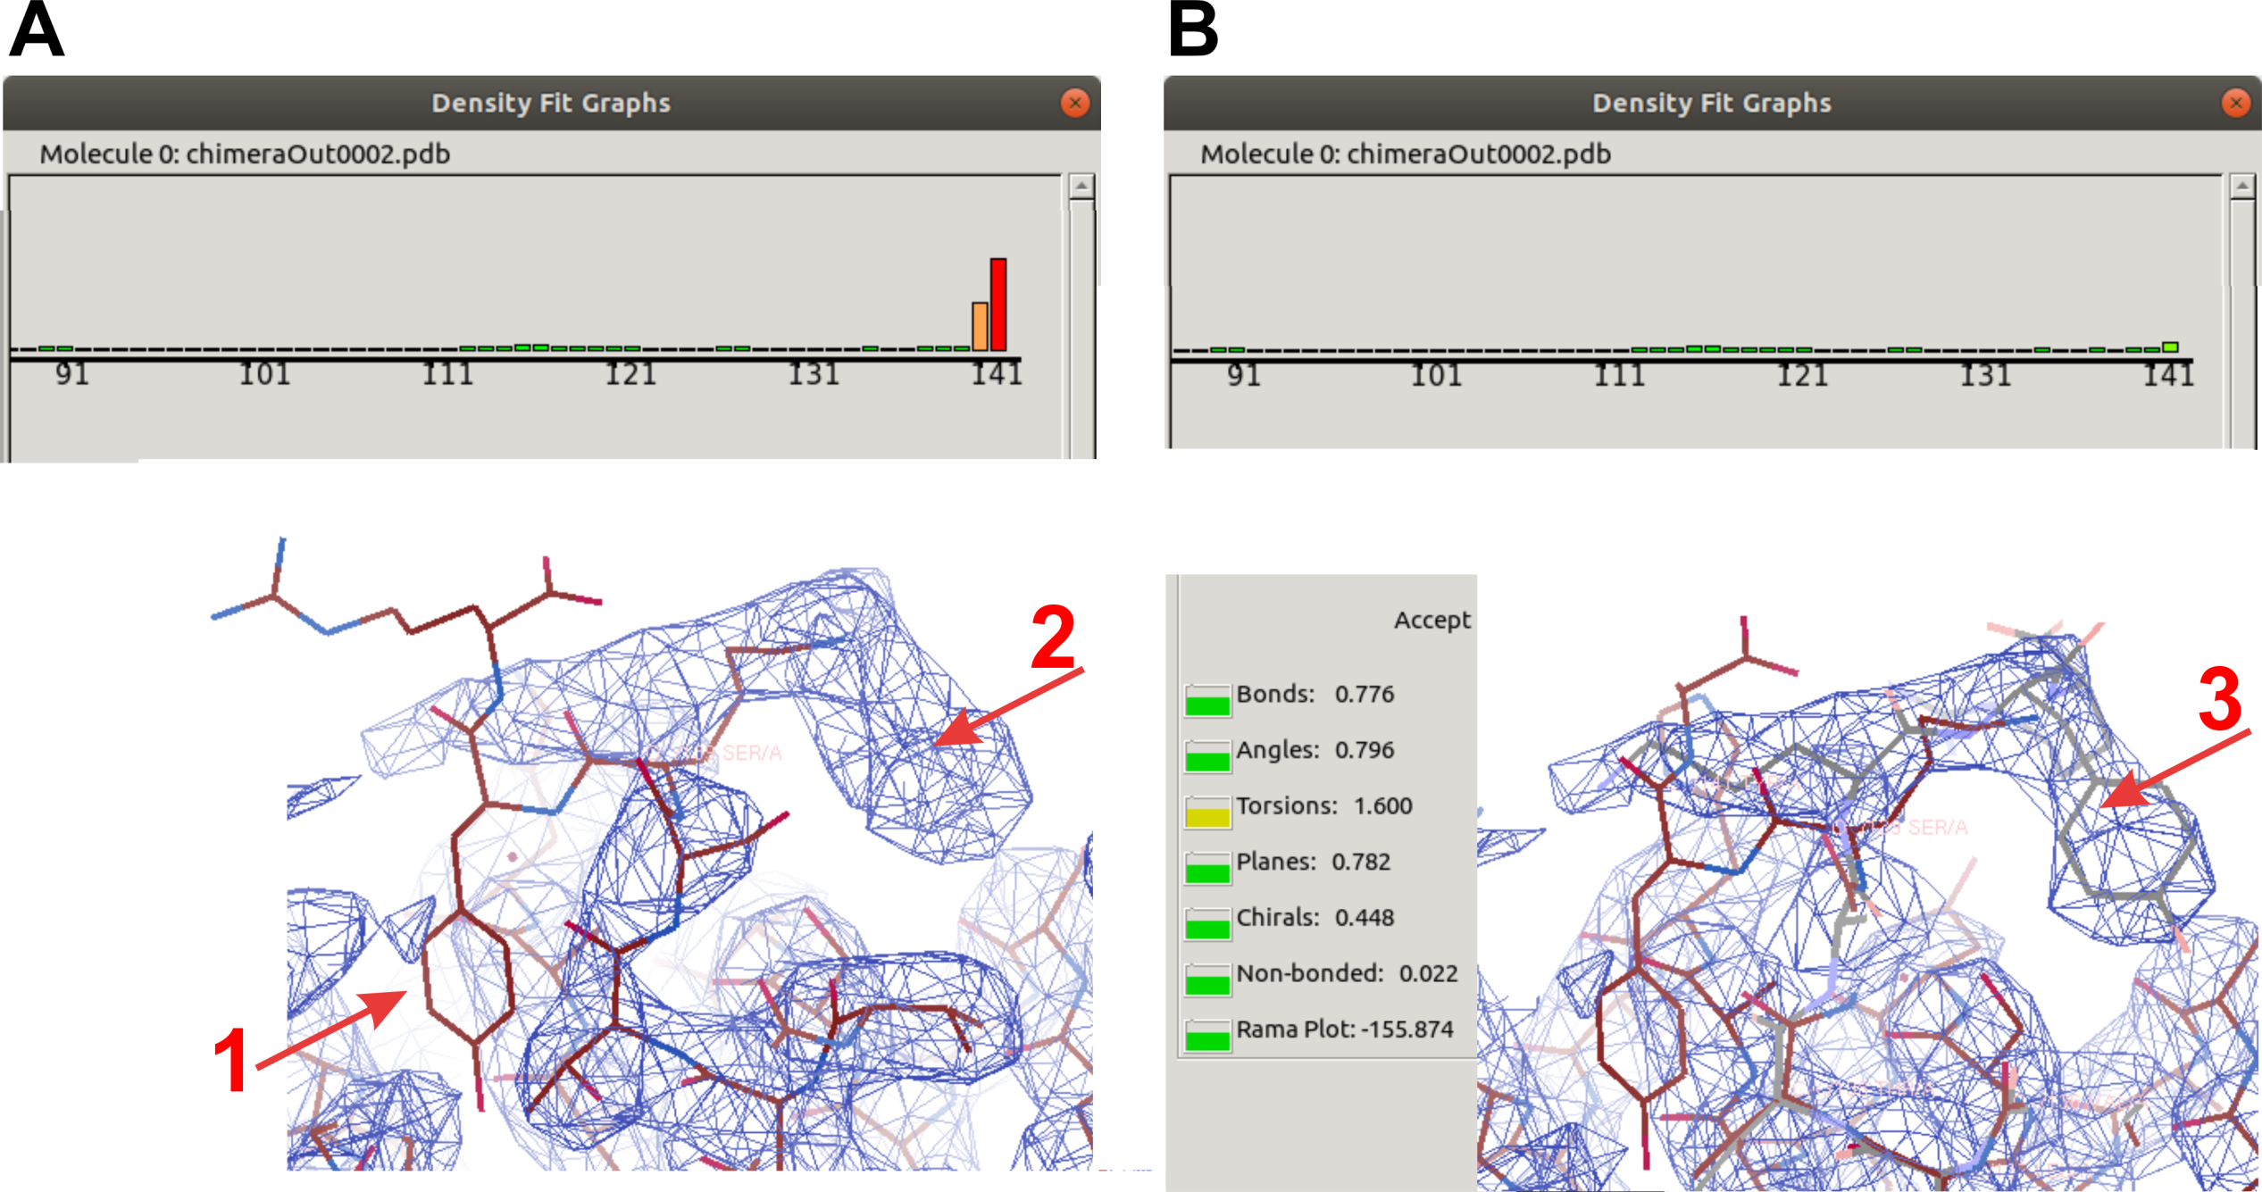

Slide 41
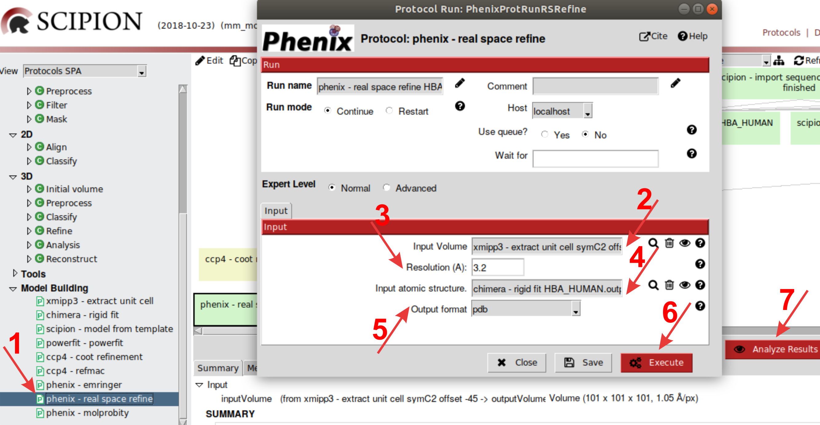

Slide 42
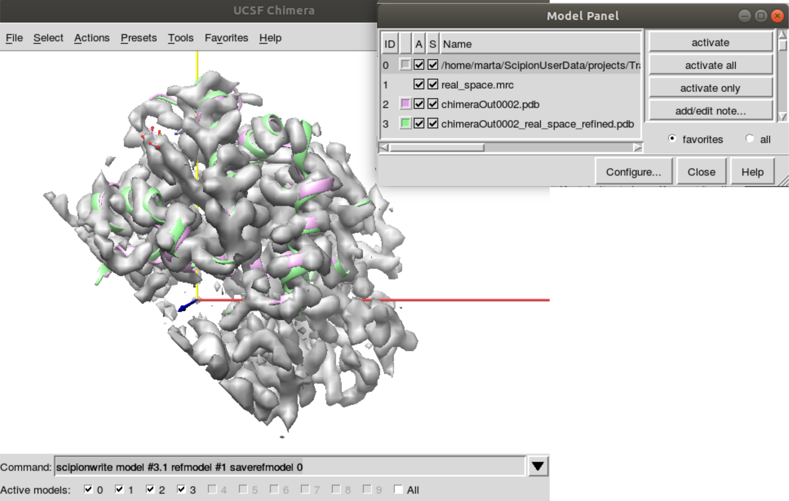

Slide 43
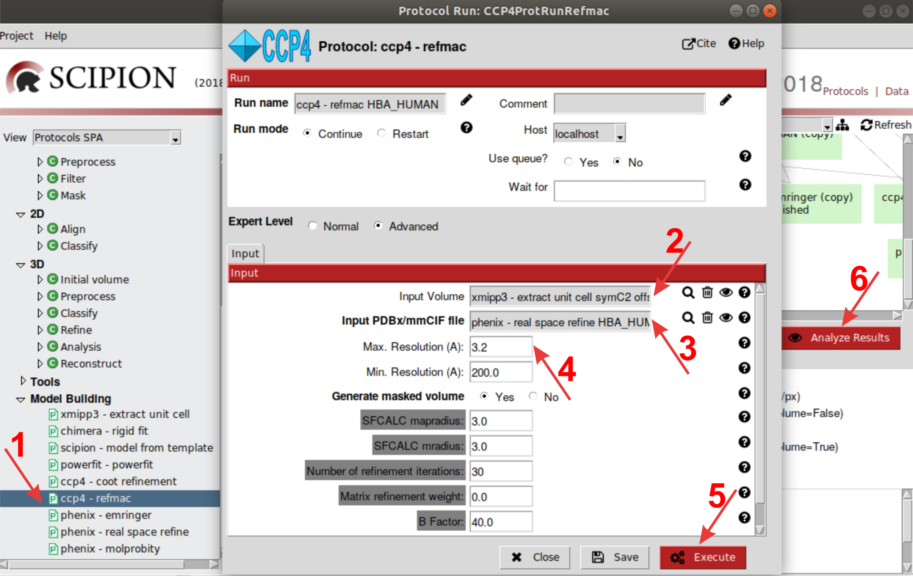

Slide 44
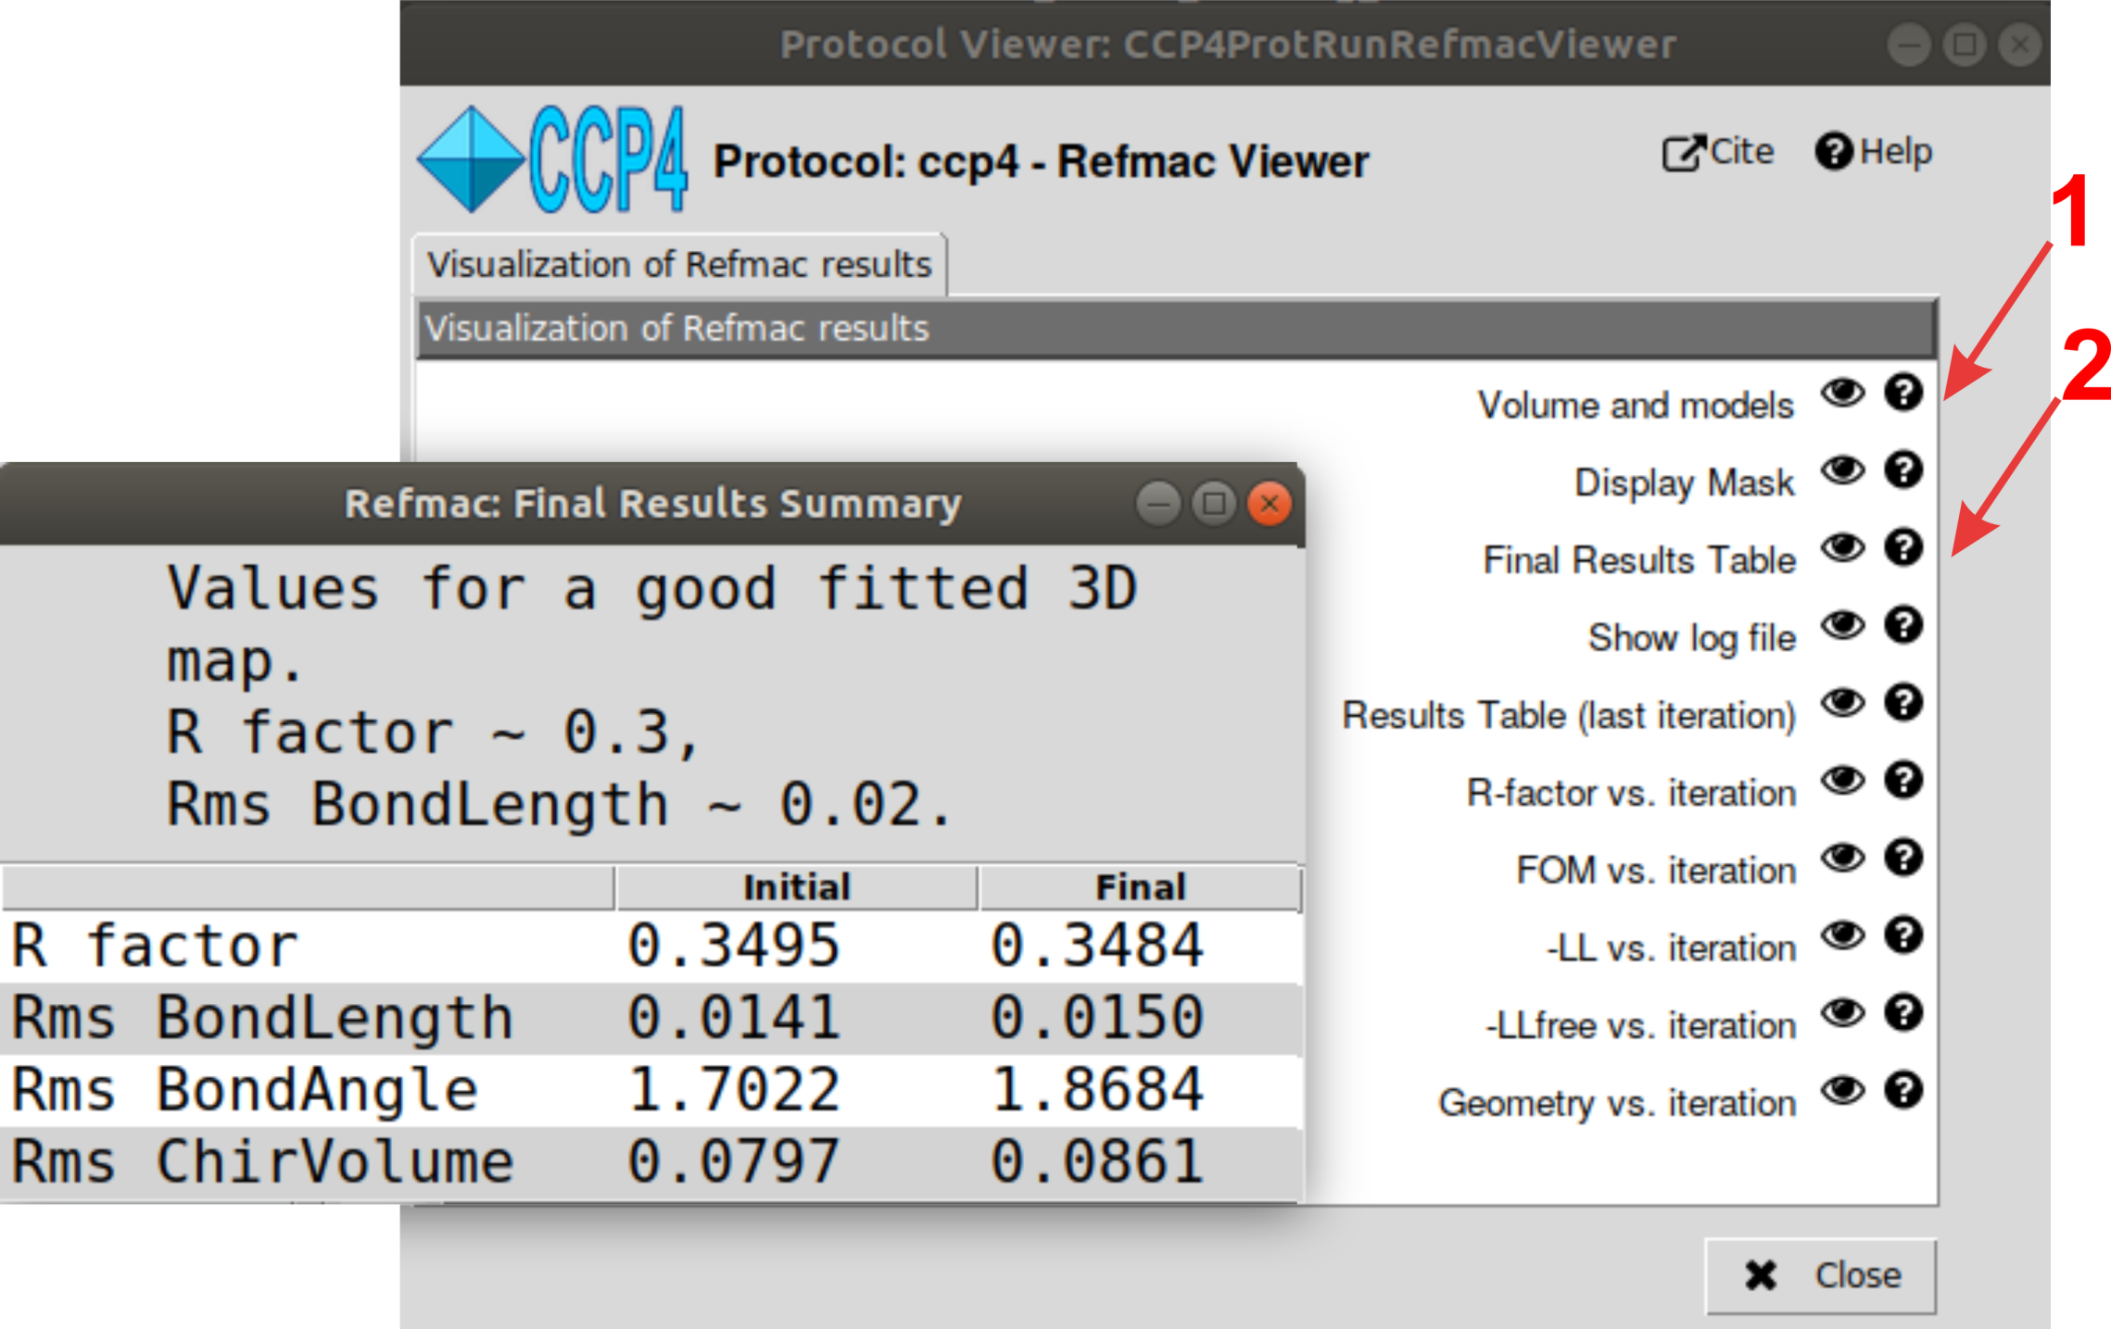

Slide 45
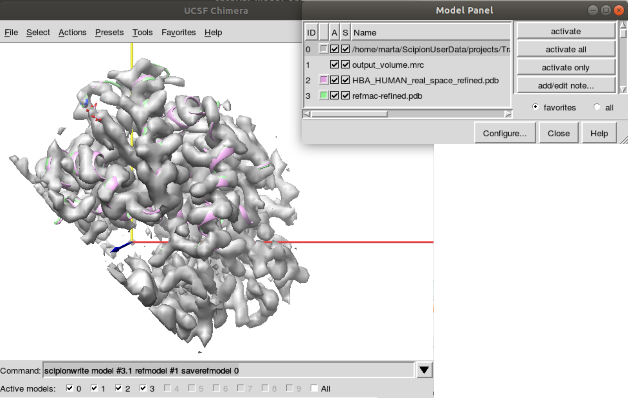

Slide 46
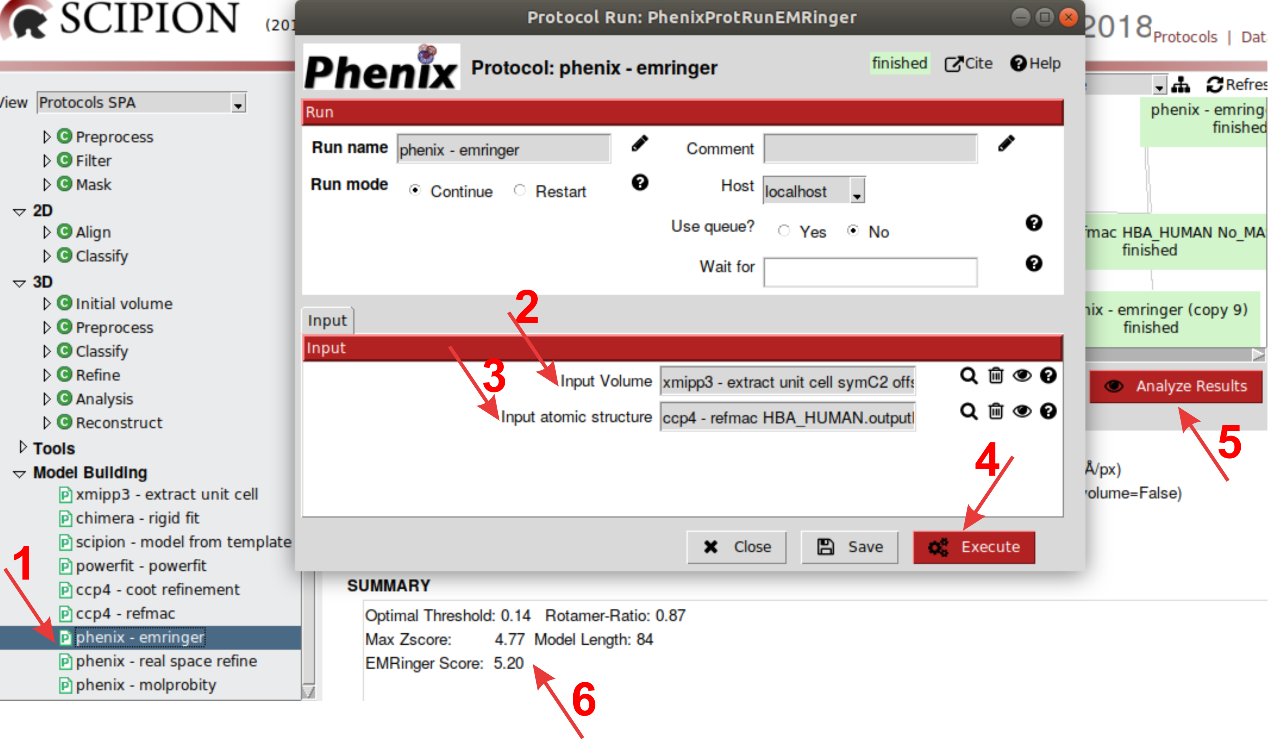

Slide 47
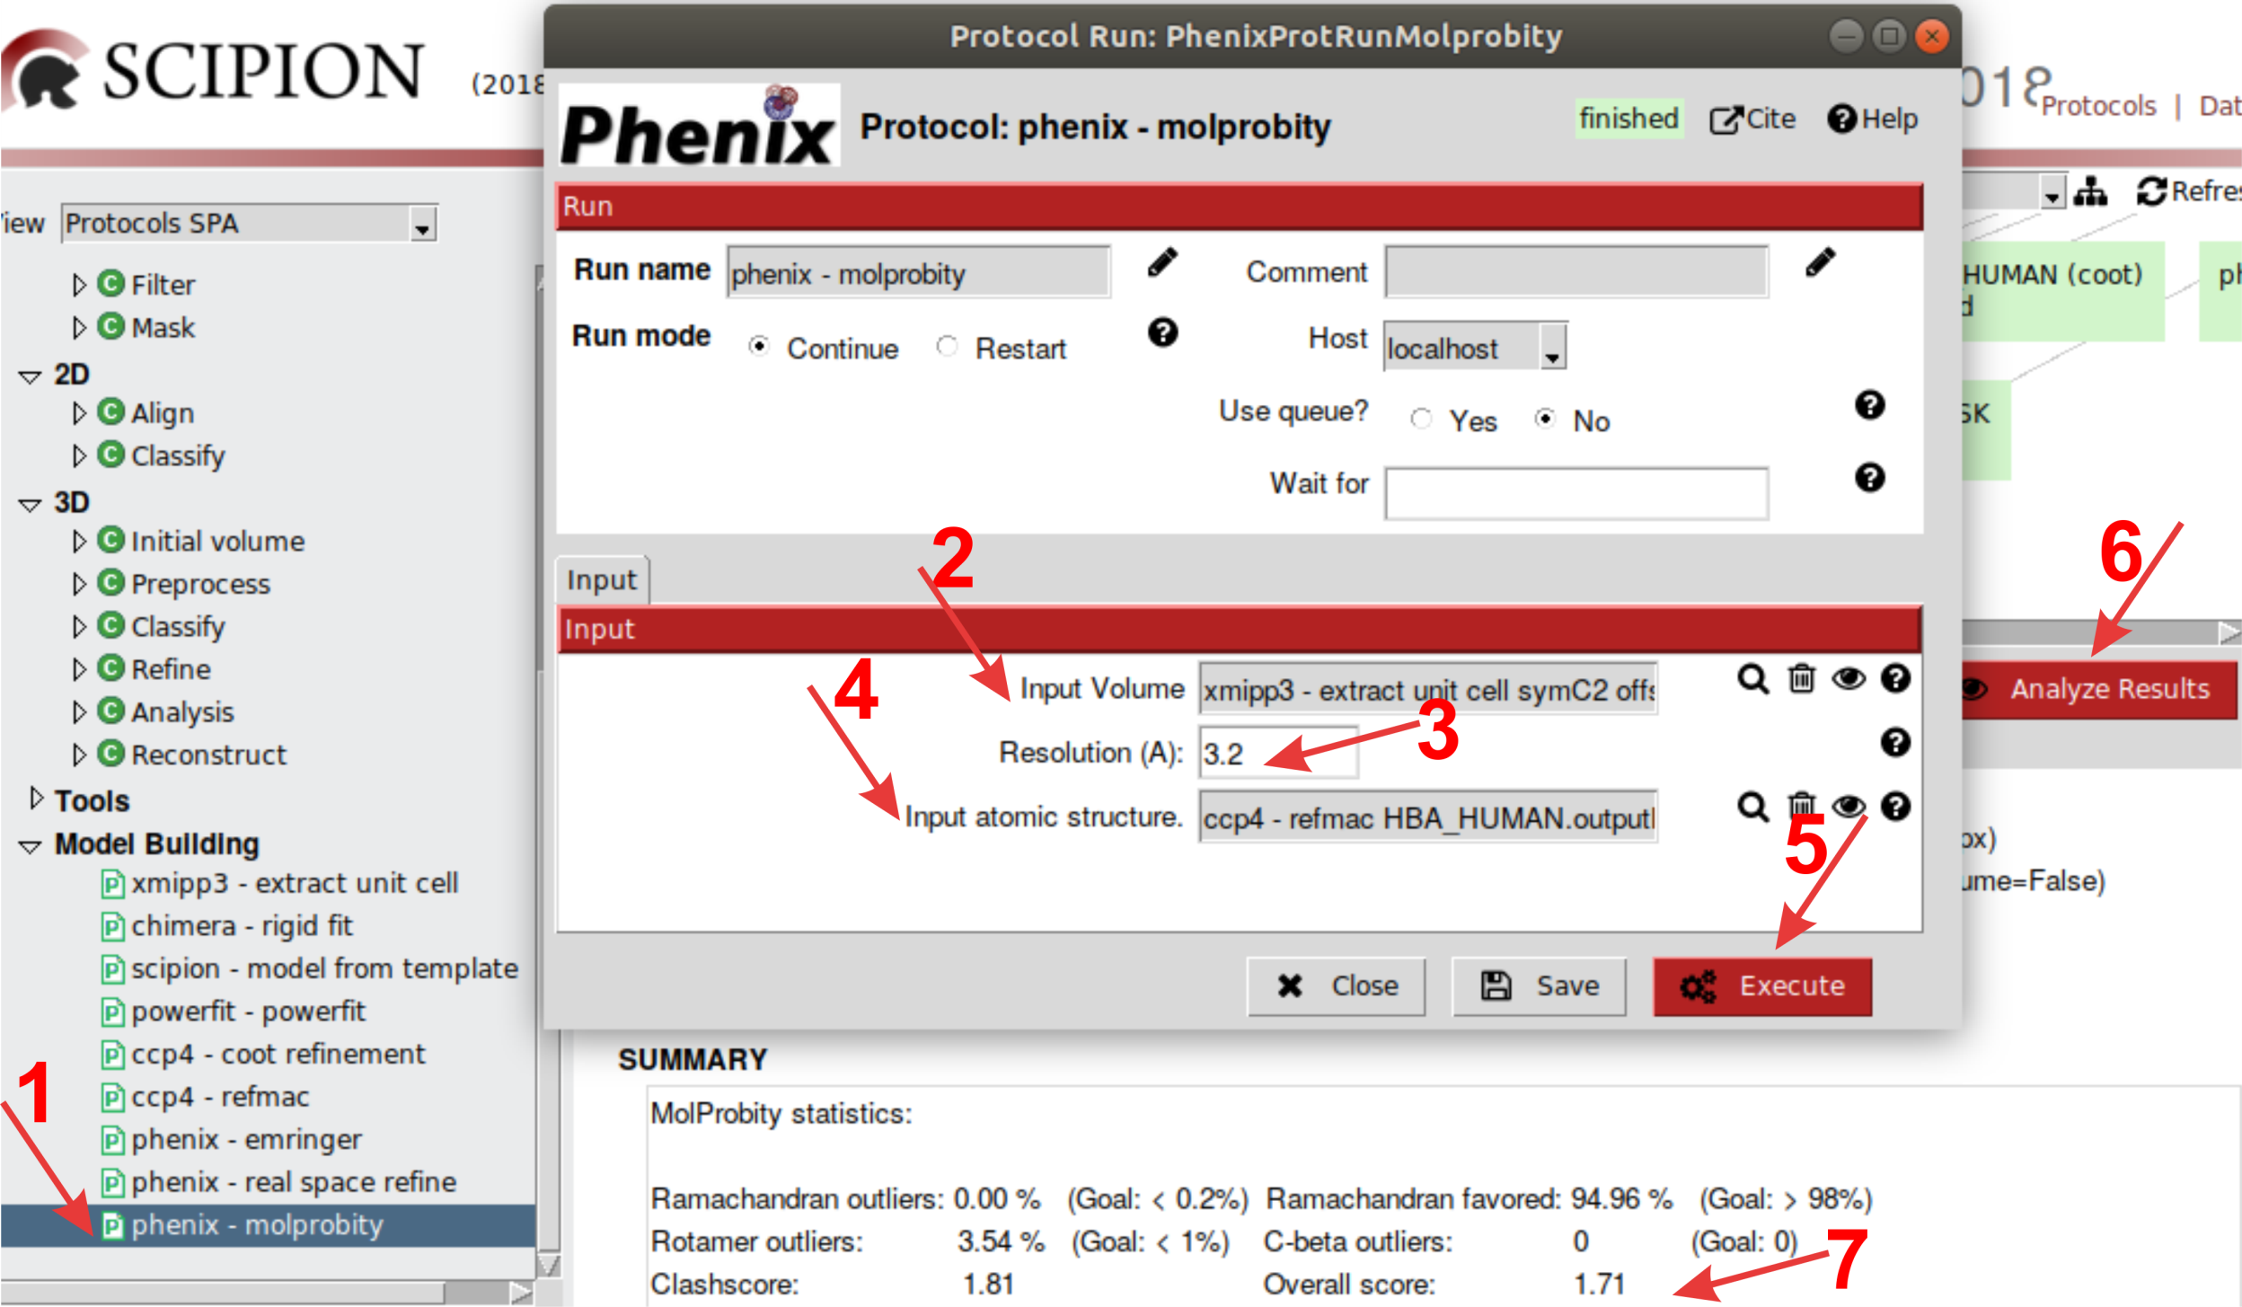

Slide 48
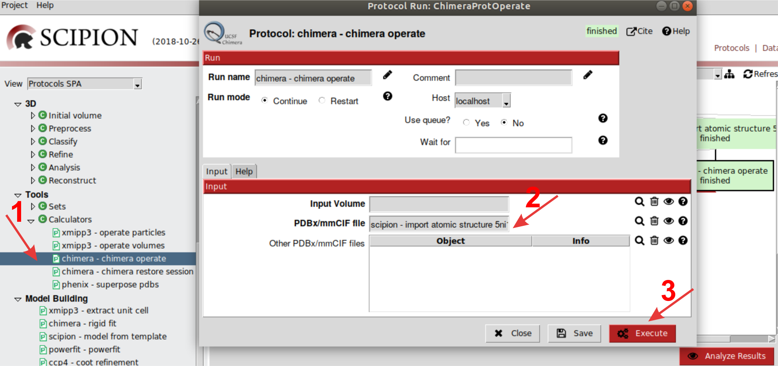

Slide 49


Slide 50


Slide 51


Slide 52


Slide 53


